Slide 1
Digital Image Processing
Image Enhancement
(Point Processing)

Slide 2
Contents
What is point processing?
Negative images
Thresholding
Logarithmic transformation
Power law transforms
Grey level slicing
Bit plane slicing

Slide 3
What Is Image Enhancement?
Image enhancement is the process of making images more useful.
The reasons for doing this include:
Highlighting interesting detail in images
Removing noise from images
Making images more visually appealing

Slide 4
Spatial & Frequency Domains
There are two broad categories of image enhancement techniques
Spatial domain techniques
Direct manipulation of image pixels
Frequency domain techniques
Manipulation of Fourier transform or wavelet transform of an image
For the moment we will concentrate on techniques that operate in the spatial domain

Slide 5
So far when we have spoken about image grey level values we have said they are in the range [0, 255]
Where 0 is black and 255 is white
The range [0,255] stems from display technologies
For many of the image processing operations in this lecture grey levels are assumed to be given in the range [0.0, 1.0]

Slide 6
Basic Spatial Domain Image Enhancement
Most spatial domain enhancement operations can be reduced to the form
g (x, y) = T[ f (x, y)]
where f (x, y) is the input image,
g (x, y) is the processed image and
T is some operator defined over some neighbourhood of (x, y)
Origin
x
(x, y)
y
Image f (x, y)

Slide 7
Point Operations Overview
Point operations are zero-memory operations where
a given gray level x∈[0,L] is mapped to another
gray level y∈[0,L] according to a transformation
y
L
x
L
L=255: for grayscale images

Slide 8
Lazy Man Operation
y
L
x
L
No influence on visual quality at all

Slide 9
Point Processing
The simplest spatial domain operations occur when the neighbourhood is simply the pixel itself
In this case T is referred to as a grey level transformation function or a point processing operation
Point processing operations take the form
s = T ( r )
where s refers to the processed image pixel value and
r refers to the original image pixel value

Slide 10
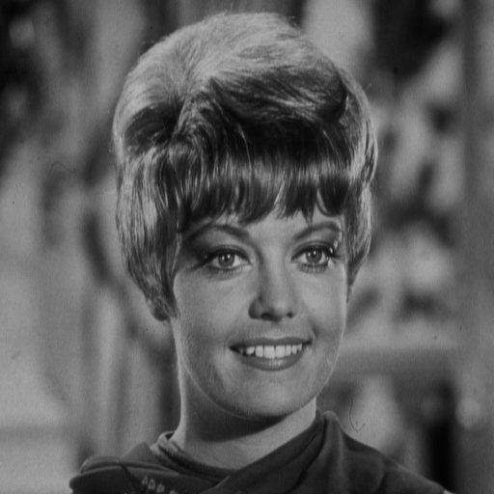
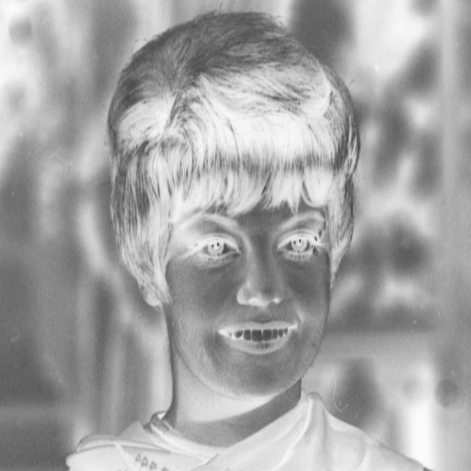
Digital Negative
L
x
0
L

Slide 11
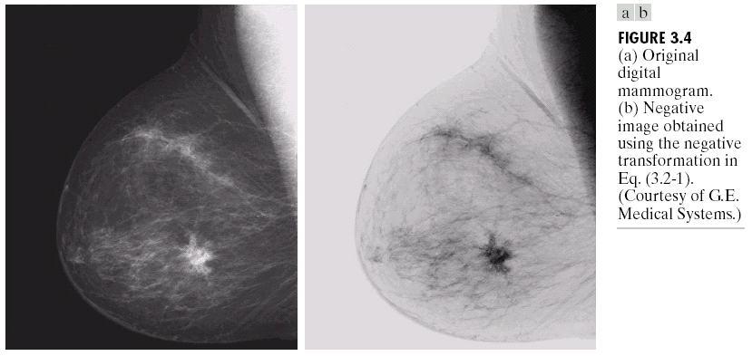
Negative Images
Negative images are useful for enhancing white or grey detail embedded in dark regions of an image.
Note how much clearer the tissue is in the negative image of the mammogram below
Original Image
s = 1.0 - r
Negative Image

Slide 12
Point Processing Example: Negative Images (cont…)
Original Image
x
Enhanced Image
x
y
Image f (x, y)
y
Image f (x, y)
s = intensity_{max} - r

Slide 13
Contrast Stretching
Contrast is reffered as the difference in gray levels or luminance values over some areas of the image.
Low contrast images can result from poor illumination, lack of dynamic range in the imaging sensor, or even wrong setting of a lens aperture during image acquisition.
Contrast stretching is a simple image enhancement technique that attempts to improve the contrast in an image by `stretching' the range of intensity values it contains to span a desired range of values, e.g. the full range of pixel values that the image type allows.
The general idea in contrast enhancement is to apply a linear or non-linear scalling trasform to obtain a new modified image.

Slide 14
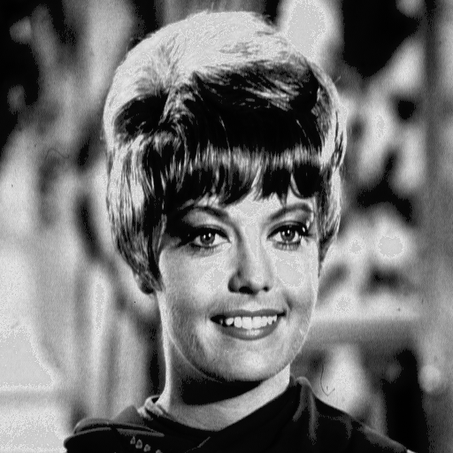
Contrast Stretching
y_{b}
y_{a}
a
b
x
0
L

Slide 15
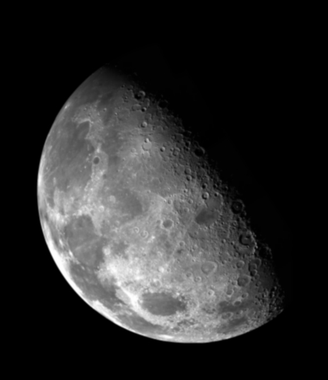
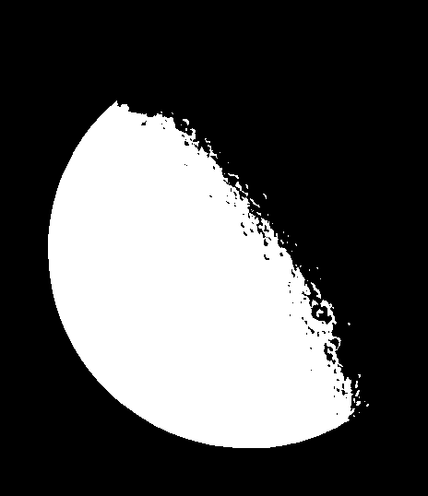
Point Processing Example: Thresholding
Thresholding transformations are particularly useful for segmentation in which we want to isolate an object of interest from a background
1.0
r > threshold
s =
0.0
r <= threshold

Slide 16
Point Processing Example: Thresholding (cont…)
Original Image
x
Enhanced Image
x
y
Image f (x, y)
y
Image f (x, y)
1.0 r > threshold
s =
0.0 r <= threshold

Slide 17
Intensity Transformations

Slide 18
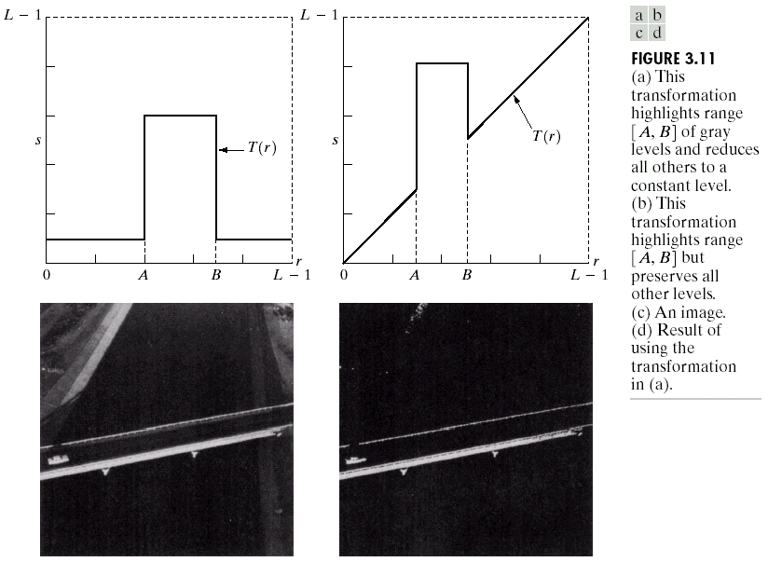
Gray Level Slicing
Highlights a specific range of grey levels
Similar to thresholding
Other levels can be suppressed or maintained
Useful for highlighting features in satellite and X-ray images.

Slide 19
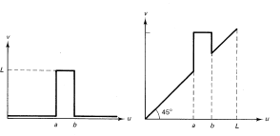
a) without background b) with background

Slide 20
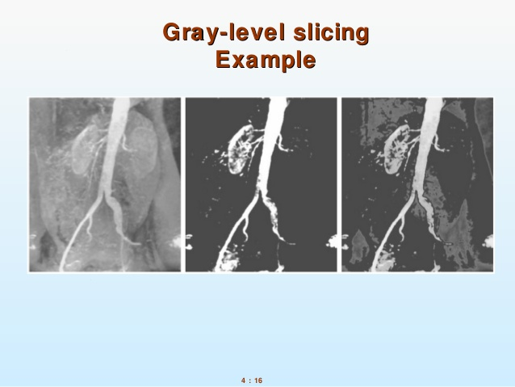
Gray Level Slicing

Slide 21
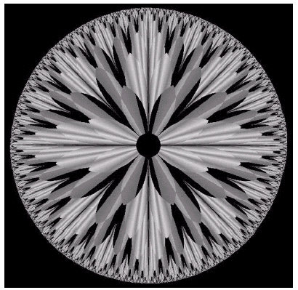
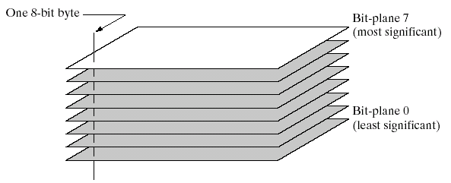
Bit Plane Slicing
Often by isolating particular bits of the pixel values in an image we can highlight interesting aspects of that image
Higher-order bits usually contain most of the significant visual information
Lower-order bits contain subtle details

Slide 22
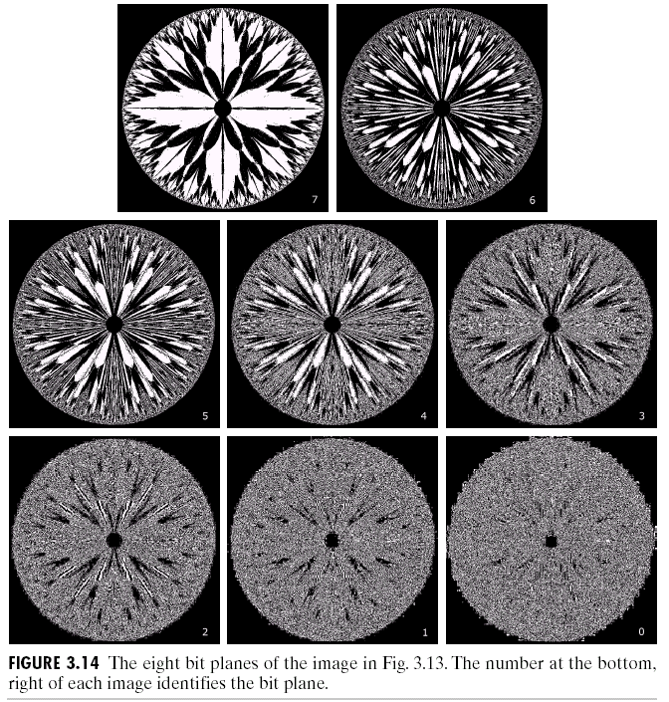
Bit Plane Slicing (cont…)
[10000000]
[01000000]
[00100000]
[00001000]
[00000100]
[00000001]

Slide 23
Bit Plane Slicing (cont…)
[10000000]
[01000000]
[00100000]
[00001000]
[00000100]
[00000001]

Slide 24
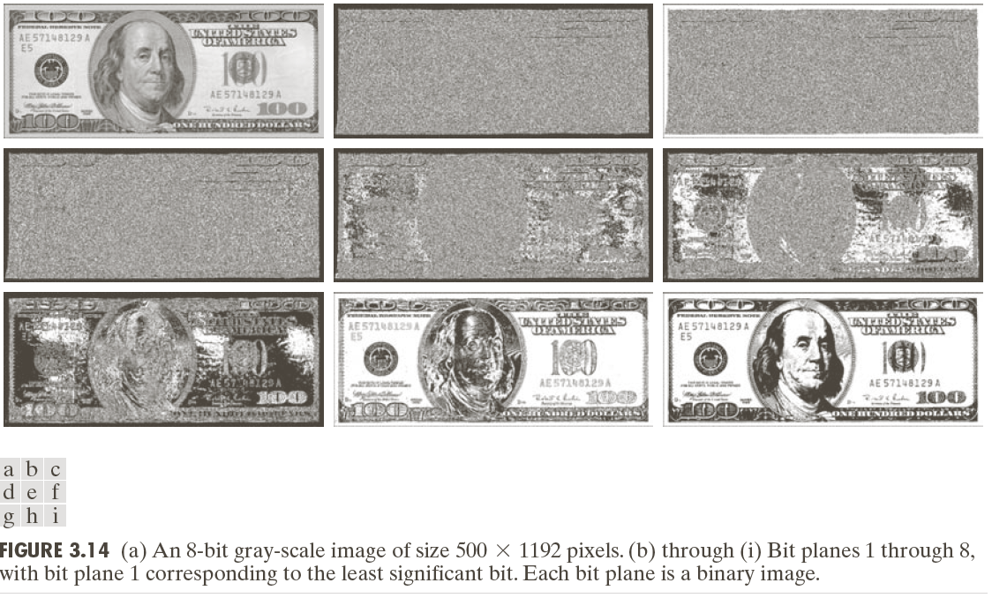
Bit Plane Slicing (cont…)

Slide 25
Bit Plane Slicing (cont…)

Slide 26
Bit Plane Slicing (cont…)

Slide 27
Bit Plane Slicing (cont…)

Slide 28
Bit Plane Slicing (cont…)

Slide 29
Bit Plane Slicing (cont…)

Slide 30
Bit Plane Slicing (cont…)

Slide 31
Bit Plane Slicing (cont…)

Slide 32
Bit Plane Slicing (cont…)

Slide 33
Bit Plane Slicing (cont…)

Slide 34
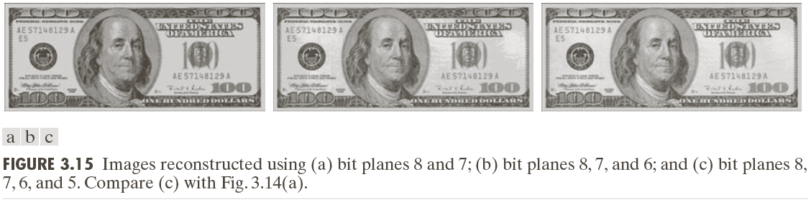
Bit Plane Slicing (cont…)
Reconstructed image using only bit planes 8 and 7
Reconstructed image using only bit planes 8, 7 and 6
Reconstructed image using only bit planes 7, 6 and 5

Slide 35
Logarithmic Transformations
The general form of the log transformation is
s = c * log(1 + r)
The log transformation maps a narrow range of low input grey level values into a wider range of output values
The inverse log transformation performs the opposite transformation

Slide 36
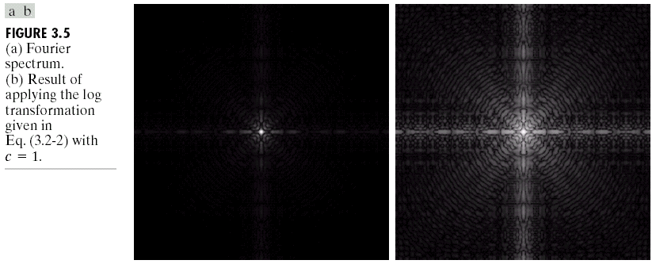
Logarithmic Transformations (cont…)
Log functions are particularly useful when the input grey level values may have an extremely large range of values
In the following example the Fourier transform of an image is put through a log transform to reveal more detail
s = log(1 + r)

Slide 37
Logarithmic Transformations (cont…)
Original Image
x
Enhanced Image
x
y
Image f (x, y)
y
Image f (x, y)
s = log(1 + r)
We usually set c to 1
Grey levels must be in the range [0.0, 1.0]

Slide 38
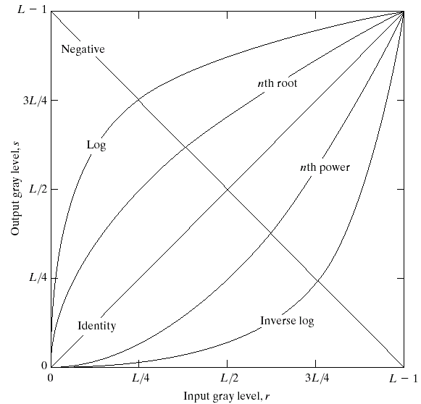
Basic Grey Level Transformations
There are many different kinds of grey level transformations
Three of the most common are shown here
Linear
Negative/Identity
Logarithmic
Log/Inverse log
Power law
n^{th} power/n^{th} root

Slide 39
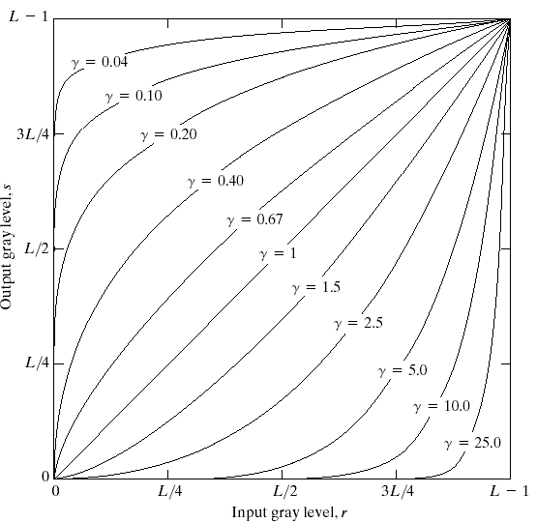
Power Law Transformations
Power law transformations have the following form
s = c * r ^{γ}
Map a narrow range of dark input values into a wider range of output values or vice versa
Varying γ gives a whole family of curves

Slide 40
Power Law Transformations (cont…)
Original Image
x
Enhanced Image
x
y
Image f (x, y)
y
Image f (x, y)
s = r ^{γ}
We usually set c to 1
Grey levels must be in the range [0.0, 1.0]

Slide 41
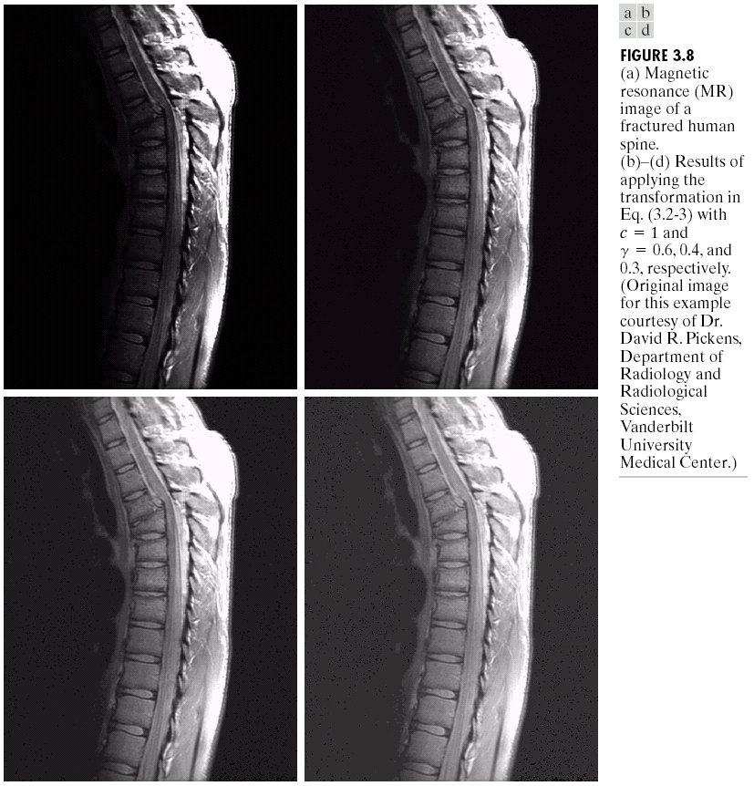
Power Law Example

Slide 42
Power Law Example (cont…)
γ = 0.6

Slide 43
Power Law Example (cont…)
γ = 0.4

Slide 44
Power Law Example (cont…)
γ = 0.3

Slide 45
Power Law Example (cont…)
The images to the right show a magnetic resonance (MR) image of a fractured human spine
Different curves highlight different detail
s = r ^{0.6}
s = r ^{0.3}
s = r ^{0.4}
Notes:
The third transform is a step too far

Slide 46
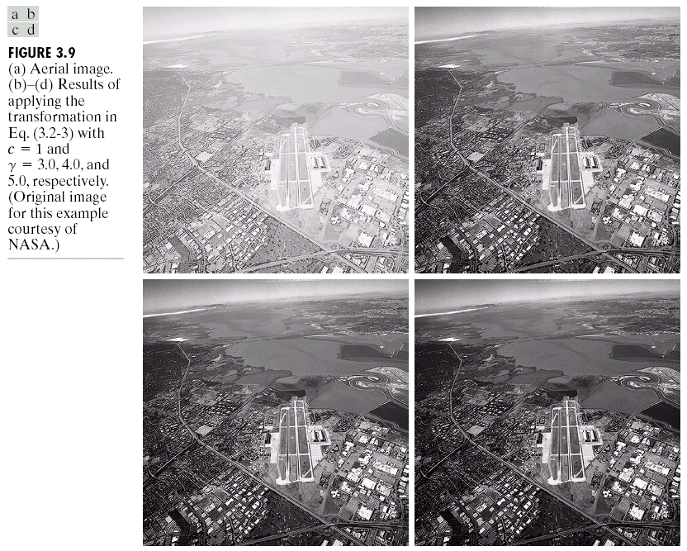
Power Law Example

Slide 47
Power Law Example (cont…)
γ = 5.0

Slide 48
Power Law Transformations (cont…)
An aerial photo of a runway is shown
This time power law transforms are used to darken the image
Different curves highlight different detail
s = r ^{3.0}
s = r ^{4.0}
s = r ^{5.0}

Slide 49
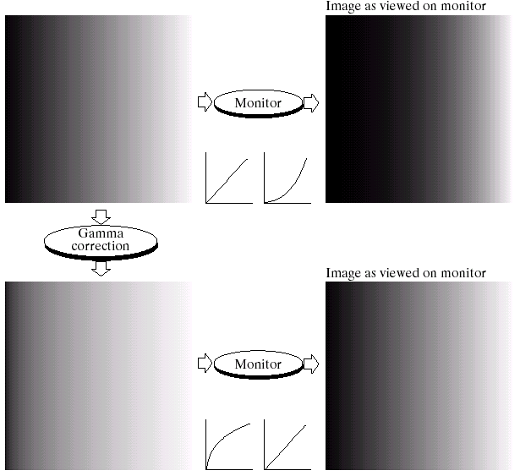
Gamma Correction
Many of you might be familiar with gamma correction of computer monitors
Problem is that display devices do not respond linearly to different intensities
Can be corrected using a log transform

Slide 50
More Contrast Issues

Slide 51
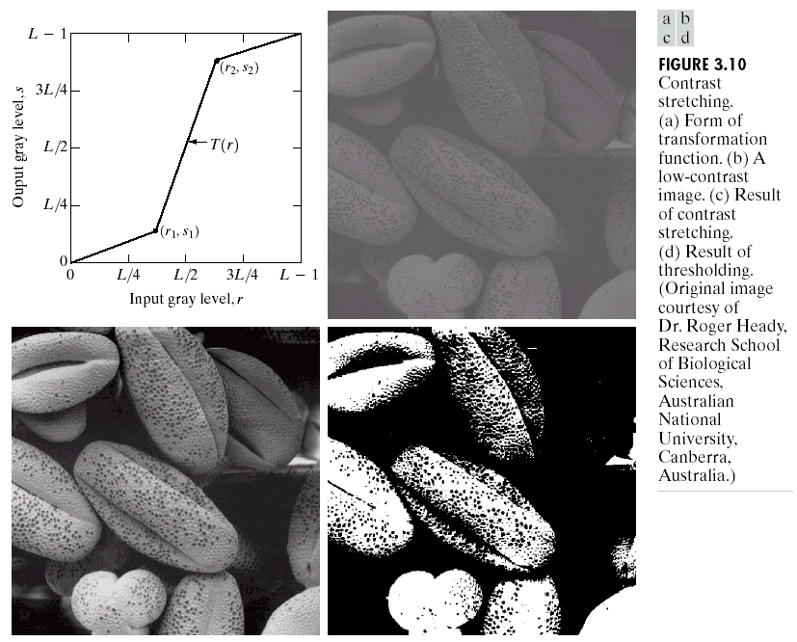
Piecewise Linear Transformation Functions
Rather than using a well defined mathematical function we can use arbitrary user-defined transforms
The images below show a contrast stretching linear transform to add contrast to a poor quality image

Slide 52
Summary
We have studied different kinds of point processing operations for image enhancement.

